Slide 1


Google Fiber Customer Call Analysis
01
INTRO
An in depth analysis of customer call patterns to the customer support at Google Fiber
02
Business Requirements
03
Methods Used
04-07
Data Insights

Slide 2

Business Problem
How to reduce customer recall volumes(customer calling support more than once)
Dashboard Link: Google Fiber Customer Call Dashboard Tableau

Slide 3
Analyzing the data in 3 dimensions:
Total Repeat Calls By first contact date
Total Repeat Calls By Market
Total Repeat Calls By Problem
Including different time scale comparisons including highlight tables by weekdays over months and repeat calls by first date

Slide 4
KPIs
Key metrics show that on every 100 calls, 31 repeat calls are received.
Meaning 30 % of the customer queries are resolved on the first call with
the support team.

Slide 5
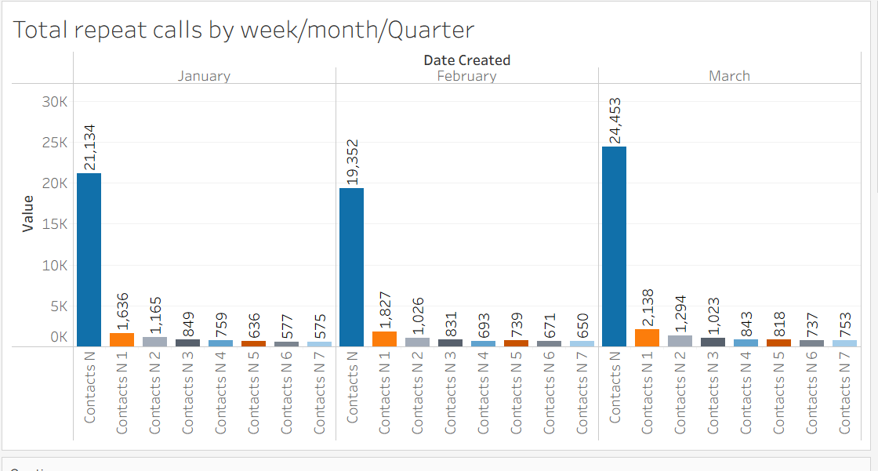
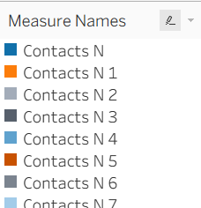
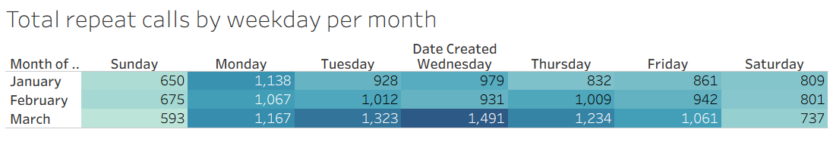
Repeat calls by first contact date
As the months are progressing the repeat call volumes are increasing.
Mon-Fri most repeat calls happen.

Slide 6
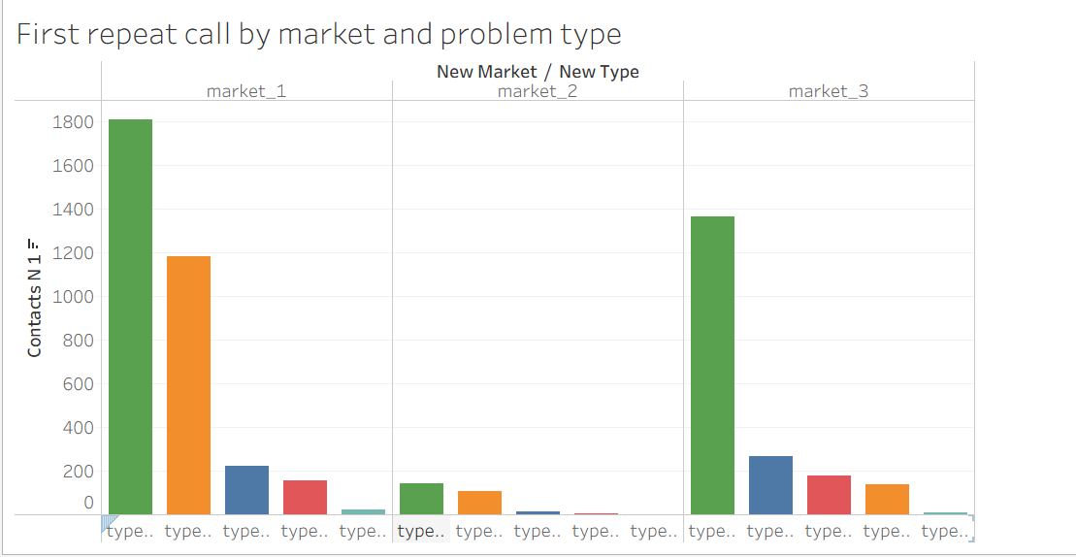
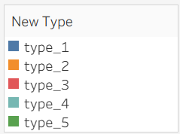
Repeat calls by Market and Problem type
Market 1 support team is facing the highest repeat calls.
Followed by Market 3
We have to work by problem type to reduce market 1 call volume

Slide 7
Repeat calls by Market and Problem type
Most calls are relating to type_5 (internet and wifi) in every market
Followed by type_2(technician troubleshooting) and type_1(account management).
Problem type has a huge impact on repeat calls

